Slide 1
Data structure and Algorithm Lesson 3: Effeciency (cont.)
DII Summer 2021
By Aj.Suttinee

Slide 2
Outline
VDO – Examples 15 minutes ( 9.45)
Group Activity 30-45 minutes (10.30)
VDO – Recursion Review 1 hours 30 minutes
VDO 1 hour
Break 15 minutes
VDO – Big O of previous recurive methods 15 minutes (12.10)
Conclusion 15 minutes

Slide 3




Exercise 1
Let n denote array.length, what is Big O of the following method ?
public static int[] sumRowOf2DArray(int[][] array) { int[] result = new int[array.length]; for (int i=0; i < array.length; i ++) { for(int j =0; j < array.length; j++) { result[i] = result[i] + array[i][j]; } } return result; }

Slide 4
Exercise 2
Write an algorithm to find the smallest number in an array
Let n denote the size of an array, what is the Big O of your algorithm ?
Let n denote the size of an array, what is the Big Omega of your algorithm ?

Slide 5
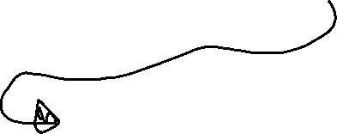











Exercise 3
public static int[] doSomething(int[] array) { for(int i = 0; i < array.length; i ++) { array[i] = array[i] *2; } int[] newArray = new int[array.length]; for (int i=0; i < array.length; i++) { newArray[i] = 0; for(int j = 0; j < array.length; j++) { newArray[i] += array[i]; newArray[i] += array[j]; } } return newArray; }
Let n denote array.length
What is Big O of the method ?
What is Big Omega of the method ?

Slide 6

Exercise 4
public static int[] doSomething(int[] array) { int[] newArray = new int[array.length]; if( array.length <= 5) { for (int i = 0; i < array.length; i++) { array[i] = array[i] * 2; } for (int i = 0; i < array.length; i++) { newArray[i] = 0; for (int j = 0; j < array.length; j++) { newArray[i] += array[i]; newArray[i] += array[j]; } } } else{ newArray = array; } return newArray; }
Let n denote array.length
What is Big O of the method ?

Slide 7
Exercise 5
public static int[] doSomething(int[] array) { int[] newArray = new int[array.length]; if( array.length >= 5) { for (int i = 0; i < array.length; i++) { array[i] = array[i] * 2; } for (int i = 0; i < array.length; i++) { newArray[i] = 0; for (int j = 0; j < array.length; j++) { newArray[i] += array[i]; newArray[i] += array[j]; } } } else{ for (int i = 0; i < array.length; i++) { newArray[i] = array[i] * 2; } } return newArray; }
Let n denote array.length
What is Big O of the method ?

Slide 8
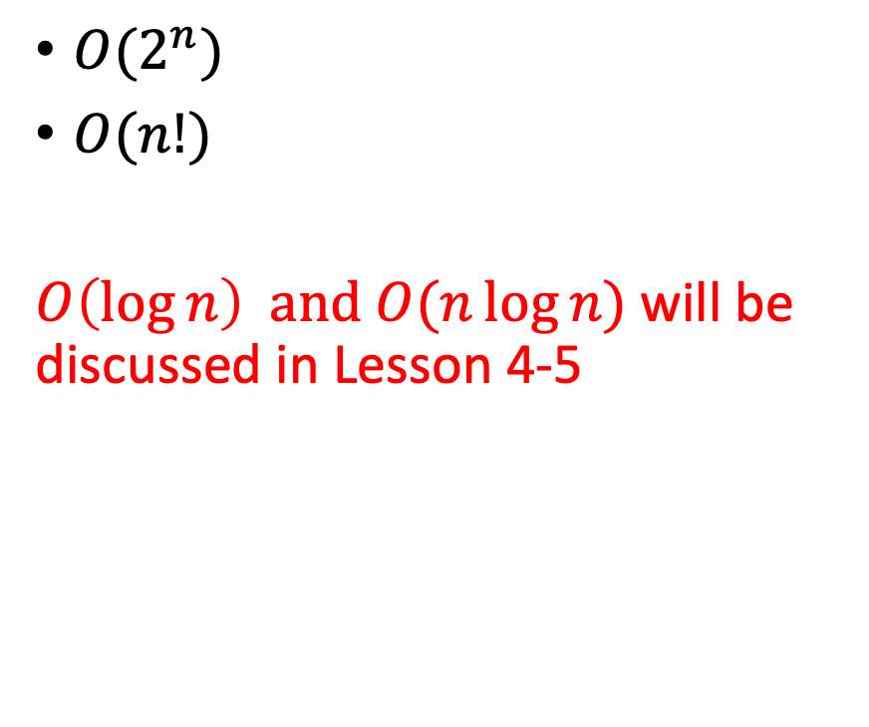

Types of Big O
$O(1)$
$O(n)$
${O(n}^{2})$
${O(n}^{3})$
${O(n}^{4})$
${O(2}^{n})$
$O(n!)$
$O\left(\log{n}\right)$ and $O(n\log{n})$ will be discussed in Lesson 4-5

Slide 9
Review Recursive methods

Slide 10
Recursion Review: Example 1
The computation time depends on both start and end.
Let end be a constant number, i.e., 10. Let n denote start. What is the Big O of the method ?
public class Main {
public static void main(String[] args)
{
int result = sum(5, 10);
System.out.println(result);
}
public static int sum(int start, int end)
{
if (end > start)
{
return end + sum(start, end - 1);
}
else
{
return end;
}
}
}

Slide 11
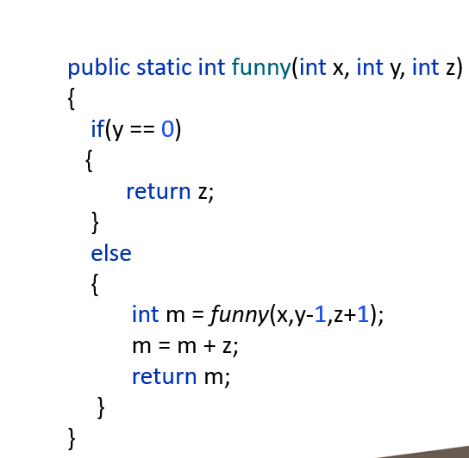
Recursion Review: Example 2
The computation time of the funny method depends on variable y
When y increases, the computation time increases accordingly.
Let n denote y, what is the Big O ?

Slide 12
Last Exam Review
public class recursive
{
public static void main(String[] args) { System.out.println(g1(5,2)); } public static int g1(int x, int y) { System.out.println("Hello"); if(x == 0) { return y; } else{ return g1(x-1,y+x); }
}
}

Slide 13
Last Exam Review
public class recursive
{ public static int fun(int n, int k)
{ int a, b; if(n == 1 || n == 2) { k=1; } else { a = fun(n-1,k); b = fun(n-2,k); k = a+b; System.out.println("f: "+ k); } return k; } public static void main(String[] args)
{ int s = 3; s = fun(5,s); System.out.println("s = "+s ); } }

Slide 14
The Fibonacci number
In mathematics, the Fibonacci numbers or Fibonacci series or Fibonacci sequence are the numbers in the following integer sequence:
0, 1, 1, 2, 3, 5, 8, 13, 21, 34, 55, 89, 144, …
By definition, the first two numbers in the Fibonacci sequence are 0 and 1, and each subsequent number is the sum of the previous two.
The number in the sequence is defined by the index for example
Index | 0 | 1 | 2 | 3 | 4 | 5 | 6
Fibonacci number | 0 | 1 | 1 | 2 | 3 | 5 | 8

Slide 15
The Fibonacci number
Index | 0 | 1 | 2 | 3 | 4 | 5 | 6
Fibonacci number | 0 | 1 | 1 | 2 | 3 | 5 | 8
F(0) = 0
F(1) = 1
F(2) = 1
F(3) = F(2)+ F(1)
F(4) = F(3) + F(2)
F(5) = F(4) + F(3)
F(x) = F(x-1) + F(x-2)
How many time the method F is visited when F(3) =?
How many time the method F is visited when F(4) =?
How many time the method F is visited when F(5) =?

Slide 16
Recursion Review: Example 3
package com.company; import java.util.Scanner; public class fibonacci { public static int fibbo(int num){ System.out.println("in"); if(num == 1){ return 1; } else if(num == 2){ return 2; } else if(num == 0){ return 0; } else{ return fibbo(num-1)+fibbo(num-2); } } public static void main(String[] args) { Scanner input = new Scanner(System.in); System.out.println("Enter an index"); int x = input.nextInt(); int result = fibbo(x); System.out.println(result); } }
What is the Big O of the fibbo method ?

Slide 17
Recursion Review: Example 4
public static int nFactorial(int n){ int result=0; for( int i = 0; i < n; i ++) { result += nFactorial(n-1); } return result; }
O(n!)

Slide 18
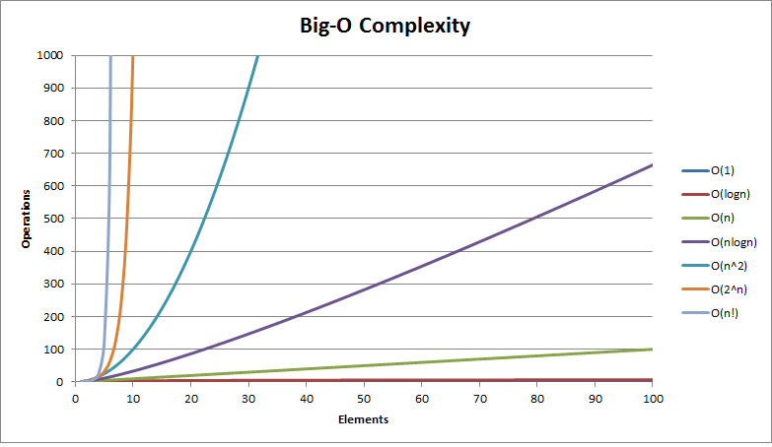
Conclusion
Time complexity
Input (n)
https://fizalihsan.github.io/technology/algorithms.html

